Slide 1

Species geographic range, and its size
Petr Keil
Notes:
Hi, my name is Petr Keil and this is my project Biodiversity dynamics across a continuum of space, time, and their scales.

Slide 2
Species geographic range
What is it?
Notes:
I am qualified to deliver all this

Slide 3
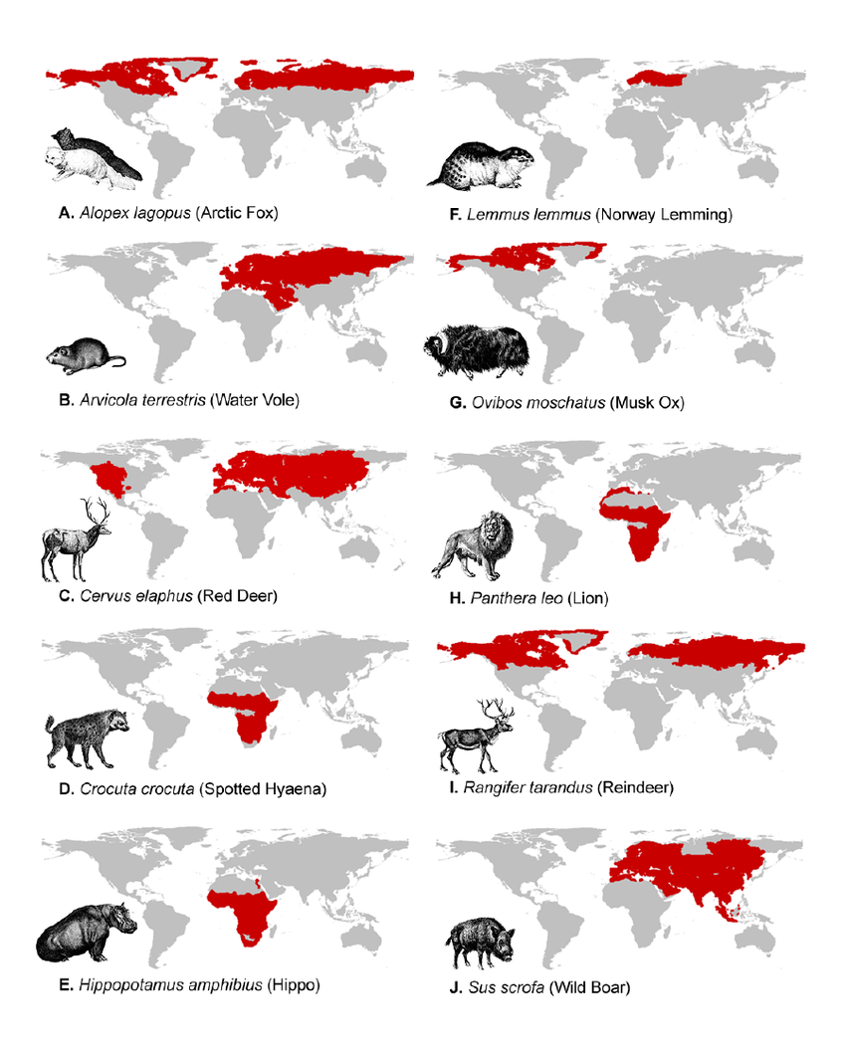
What is species geographic range?
Geographic limits of a particular species’ distribution.
The geographic area over which all the individuals of the species live.
Maps: Polly & Eronen (2011) Dev. Quarternary Sci.
Notes:
In this panel we can probably all agree that biodiversity is one of the most valuable natural resources.
But things like climate change or habitat loss are a threat to biodiversity, to the extent that we hear about biodiversity crisis, or sixth mass extinction
For example, about 1% of vertebrate species have gone extinct because of humans

Slide 4
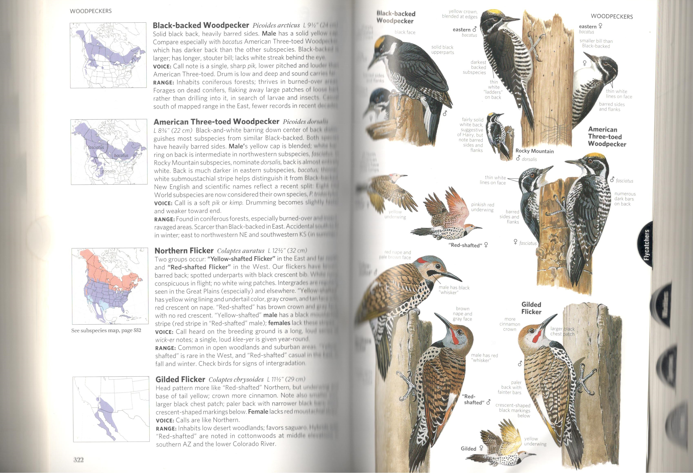
Expert-drawn range map (range map, range polygon, blob map)
Typical examples: maps in field guides, or signs in zoological gardens.
https://www.iucnredlist.org/resources/spatial-data-download
Notes:
In this panel we can probably all agree that biodiversity is one of the most valuable natural resources.
But things like climate change or habitat loss are a threat to biodiversity, to the extent that we hear about biodiversity crisis, or sixth mass extinction
For example, about 1% of vertebrate species have gone extinct because of humans

Slide 5
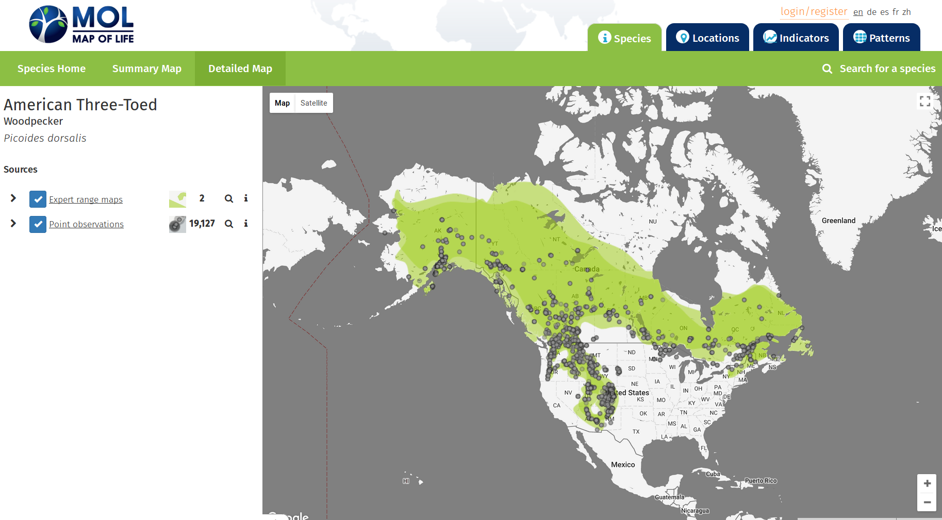
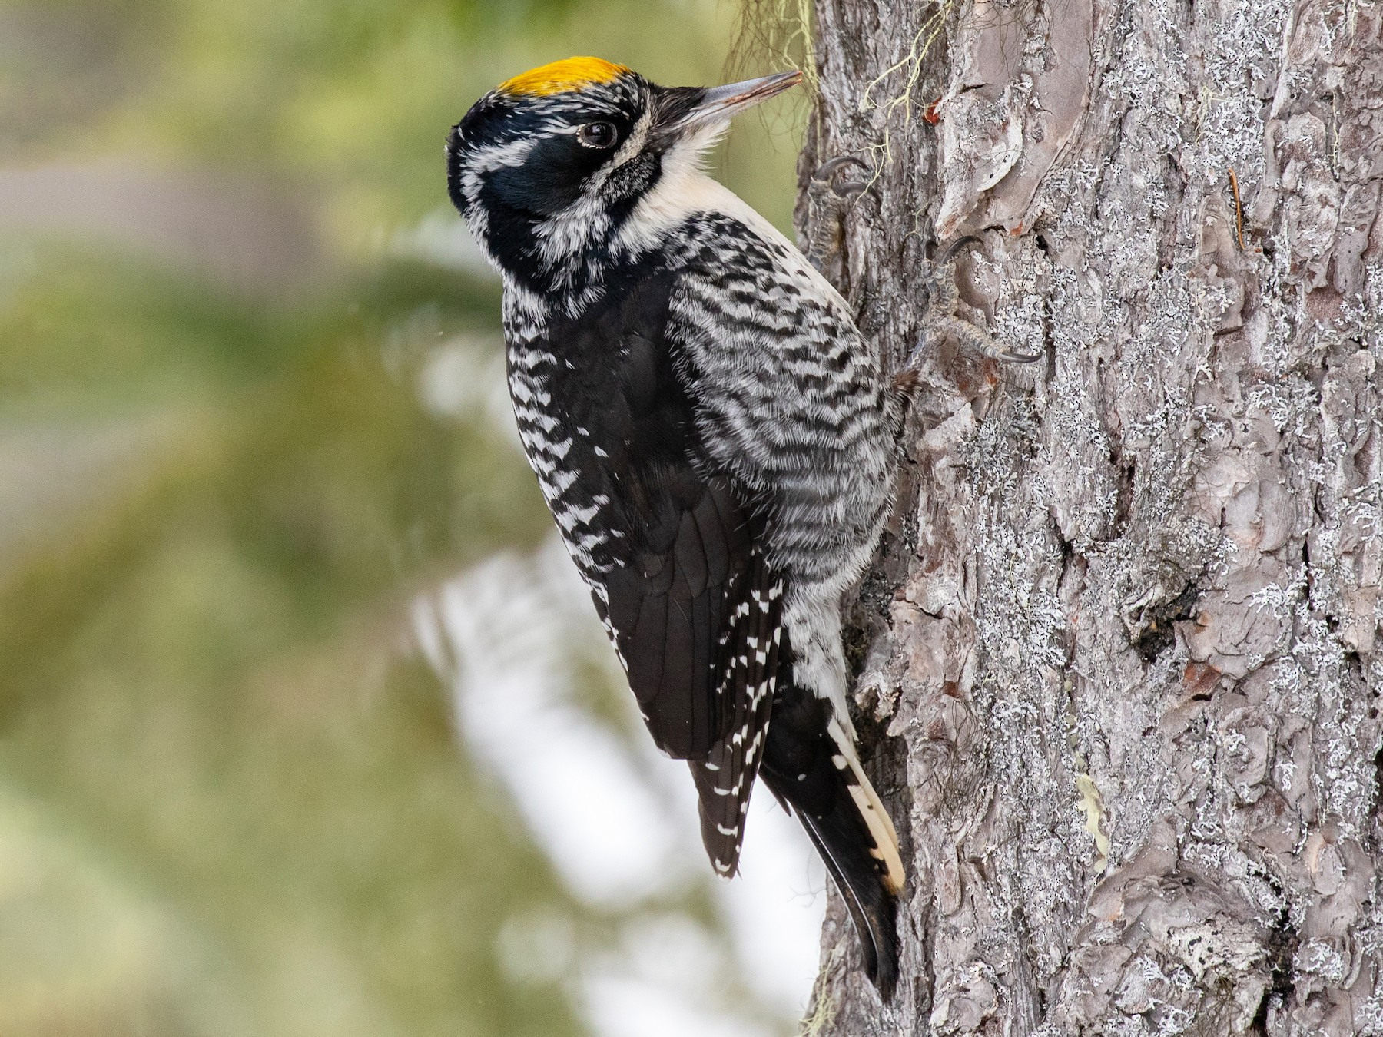
Expert-drawn range map vs point observations
https://mol.org/
Notes:
In this panel we can probably all agree that biodiversity is one of the most valuable natural resources.
But things like climate change or habitat loss are a threat to biodiversity, to the extent that we hear about biodiversity crisis, or sixth mass extinction
For example, about 1% of vertebrate species have gone extinct because of humans

Slide 6
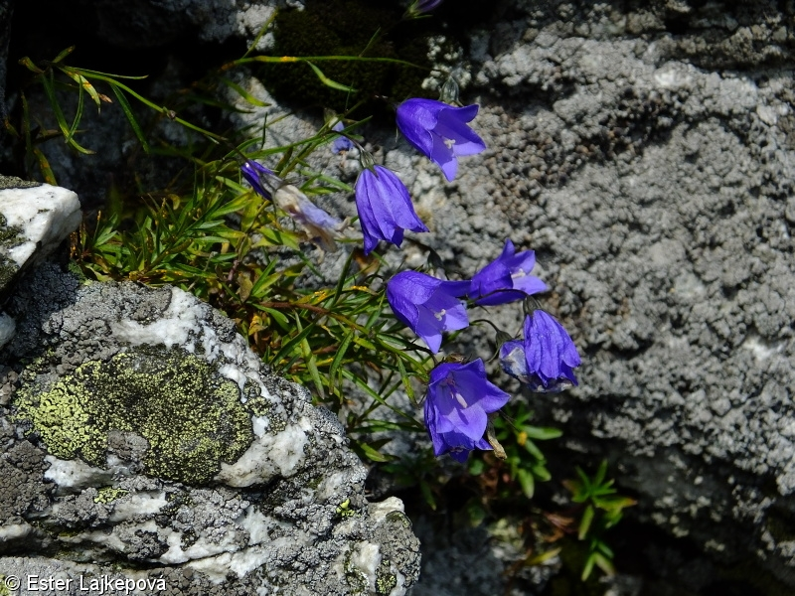
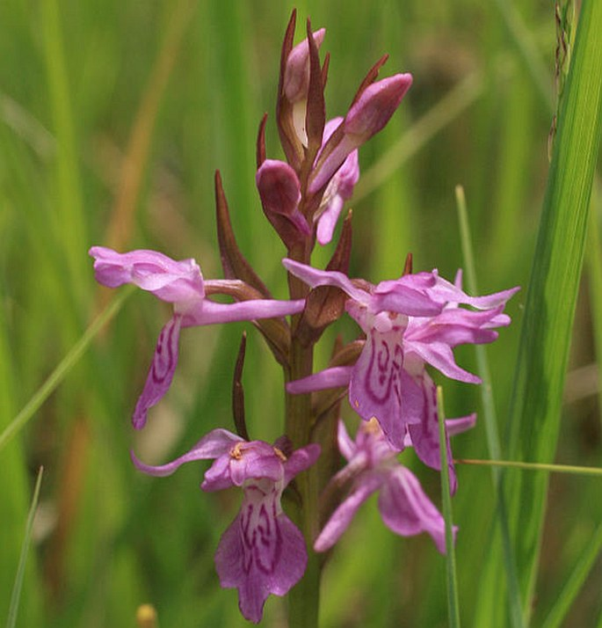
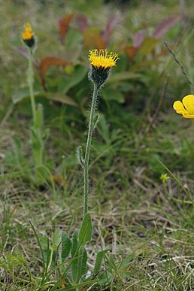
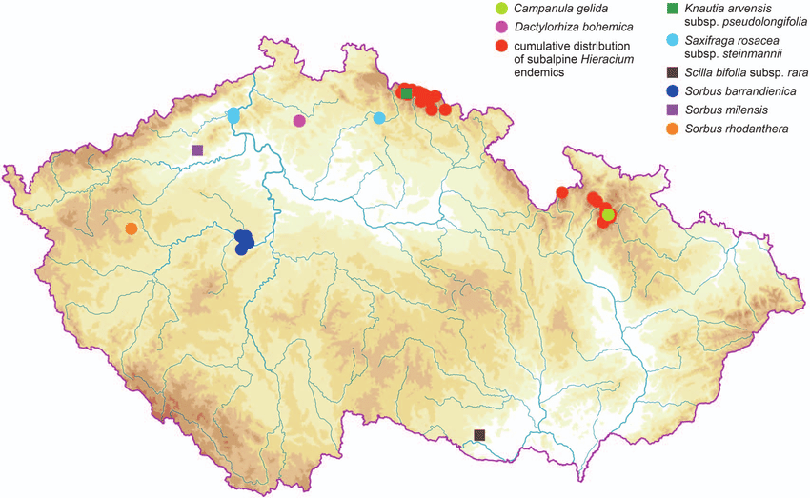
Endemic species
Species whose geographic range is
limited.
Always relative to some defined area, e.g. endemic to Krkonoše, endemic to Czech Republic, endemic to Europe, …
Can you name some other species endemic to Czech Republic?
Kaplan (2012) Preslia
Notes:
In this panel we can probably all agree that biodiversity is one of the most valuable natural resources.
But things like climate change or habitat loss are a threat to biodiversity, to the extent that we hear about biodiversity crisis, or sixth mass extinction
For example, about 1% of vertebrate species have gone extinct because of humans

Slide 7
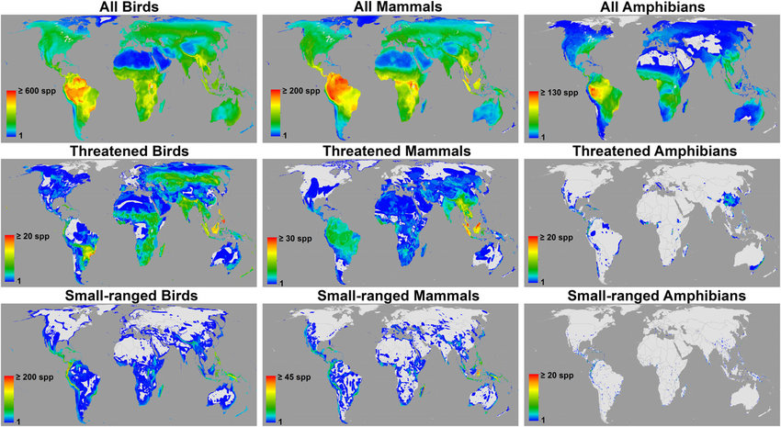
Global patterns of endemism
Compare geographic patterns of all species vs. small-ranged species. What is the difference?
Jenkins et al. (2013) PNAS
Notes:
And this is what I will address
The grand objective is to figure out…
Specifically, BEAST will ………………………
I will do this in 5 work packages.

Slide 8
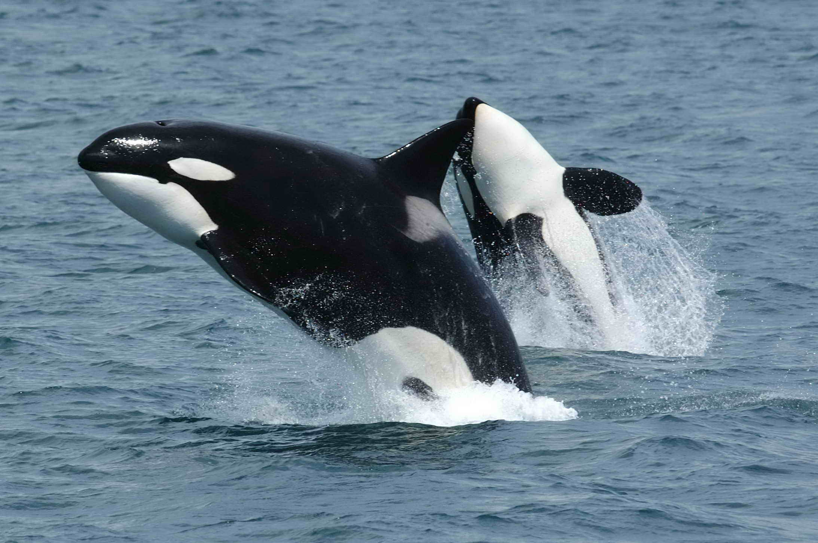
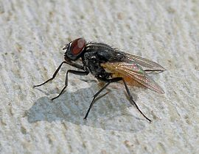
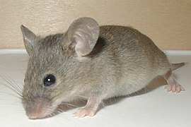
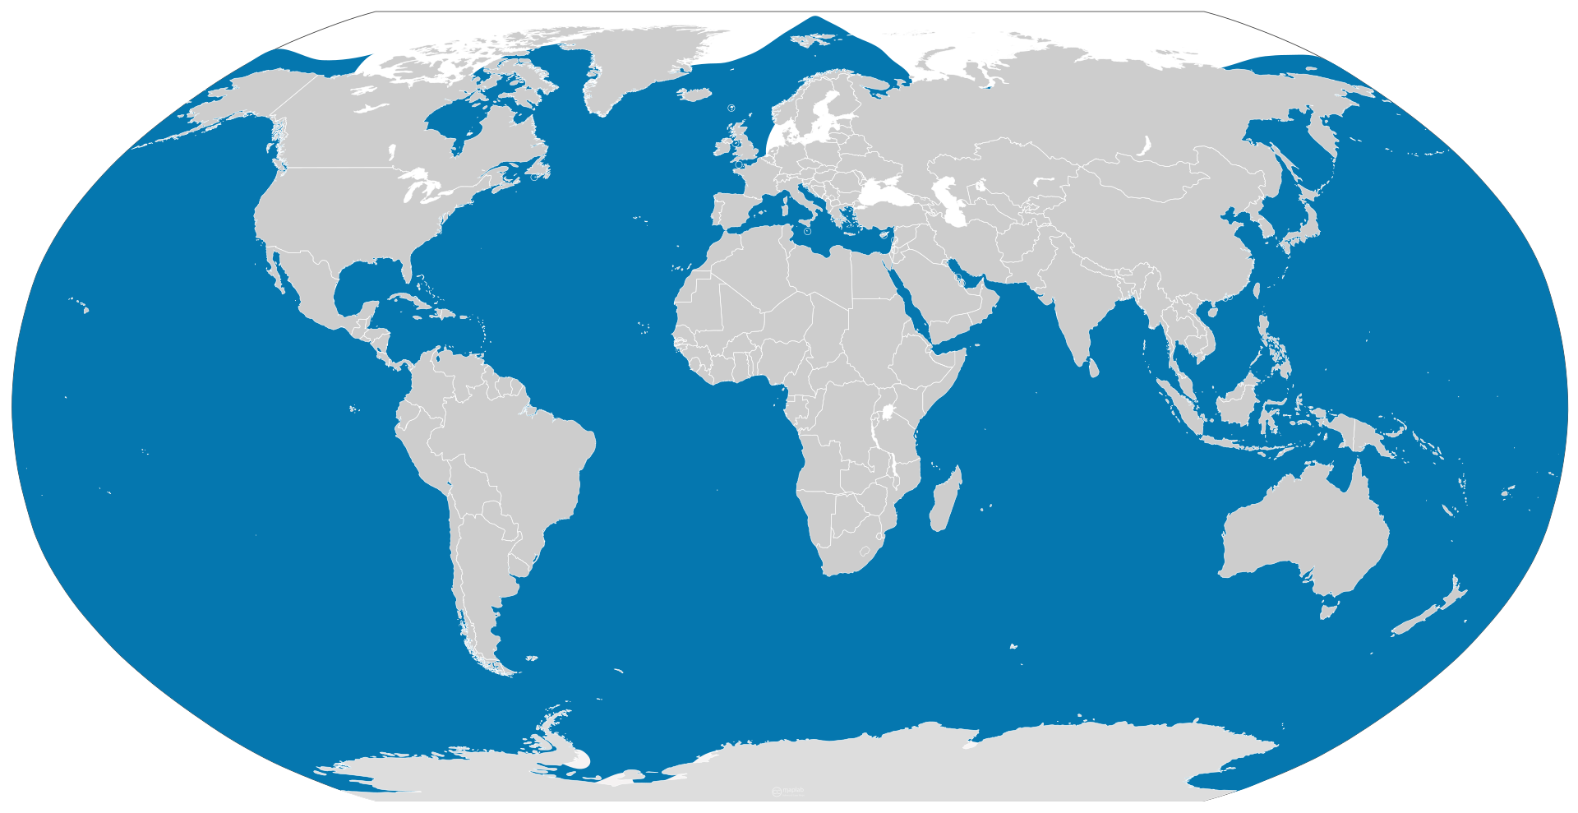
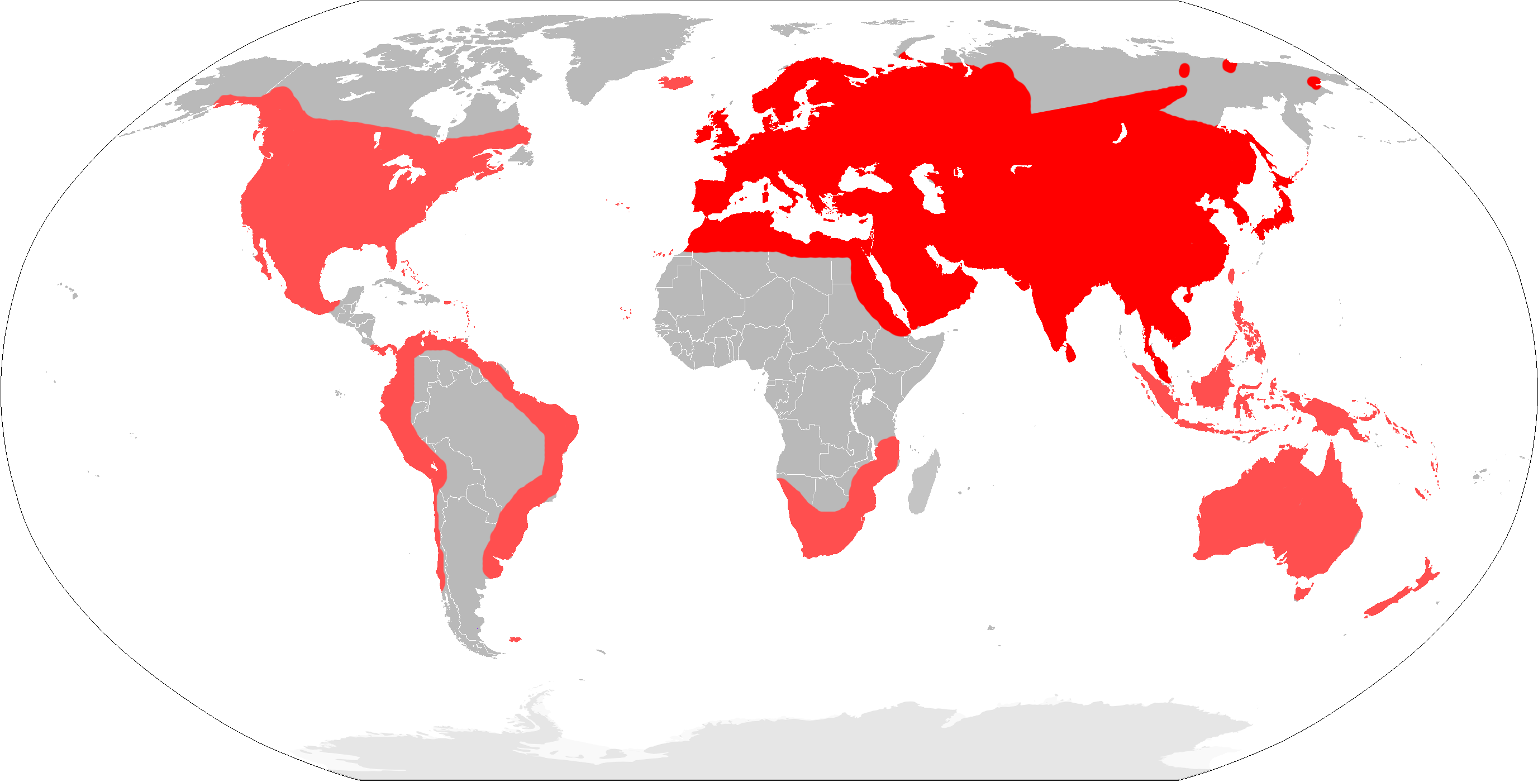
Pandemic (cosmopolitan) species
Orcinus orca
Musca domestica
Mus musculus
Images: Wikipedia
Notes:
OK, so here we are moving to the outer space
Spaceborne satellite sensors such as MODIS or Landsat can classify landscape to spectral species, and can measure spectral diversity
Unlike taxonomic data, spectral data suffer no sampling bias and are available over any scale
In WP4 I will seek parallels between dynamics of taxonomic and spectral diversity

Slide 9
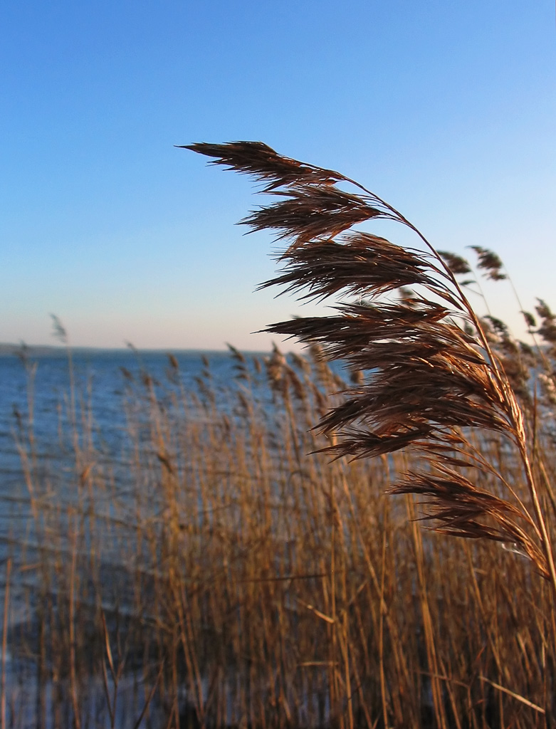
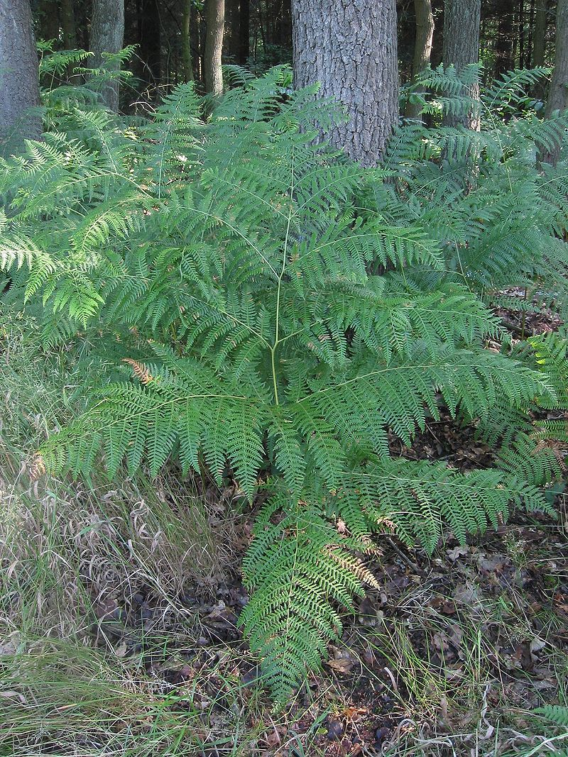
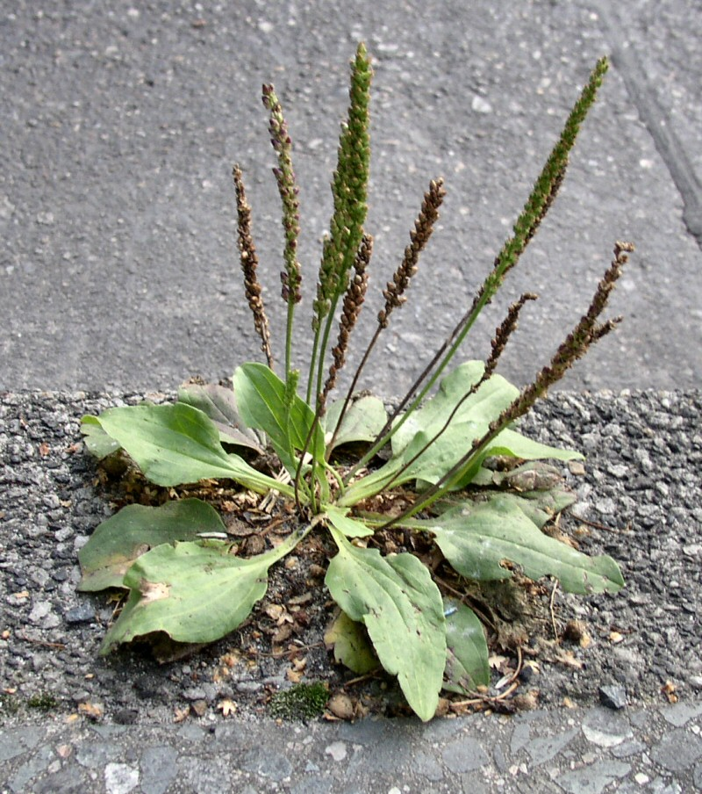
Pandemic (cosmopolitan) species
Phragmites
australis
Pteridium
aquilinium
Plantago
major
For the exam, could you name a couple of cosmopolitan species that are not mentioned here?
Images: Wikipedia
Notes:
OK, so here we are moving to the outer space
Spaceborne satellite sensors such as MODIS or Landsat can classify landscape to spectral species, and can measure spectral diversity
Unlike taxonomic data, spectral data suffer no sampling bias and are available over any scale
In WP4 I will seek parallels between dynamics of taxonomic and spectral diversity

Slide 10
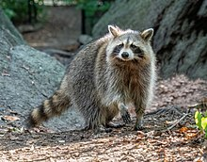
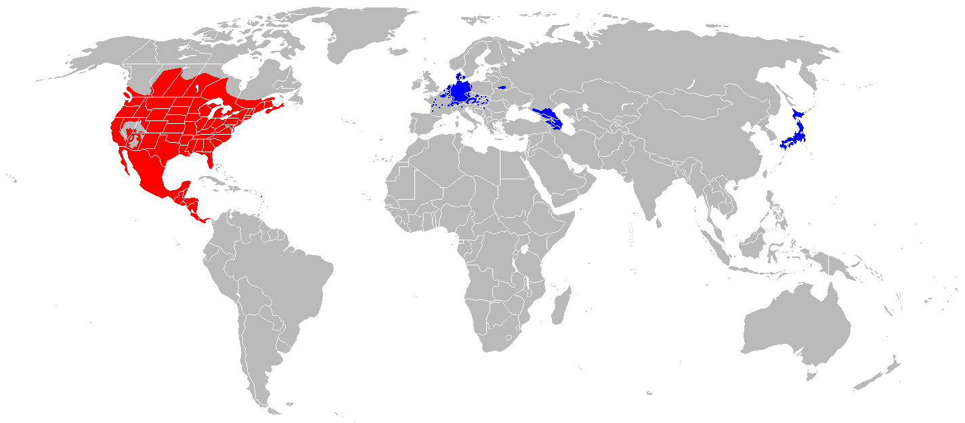
Native vs invaded range
Procyon lotor
Images: Wikipedia
Notes:
OK, so here we are moving to the outer space
Spaceborne satellite sensors such as MODIS or Landsat can classify landscape to spectral species, and can measure spectral diversity
Unlike taxonomic data, spectral data suffer no sampling bias and are available over any scale
In WP4 I will seek parallels between dynamics of taxonomic and spectral diversity

Slide 11
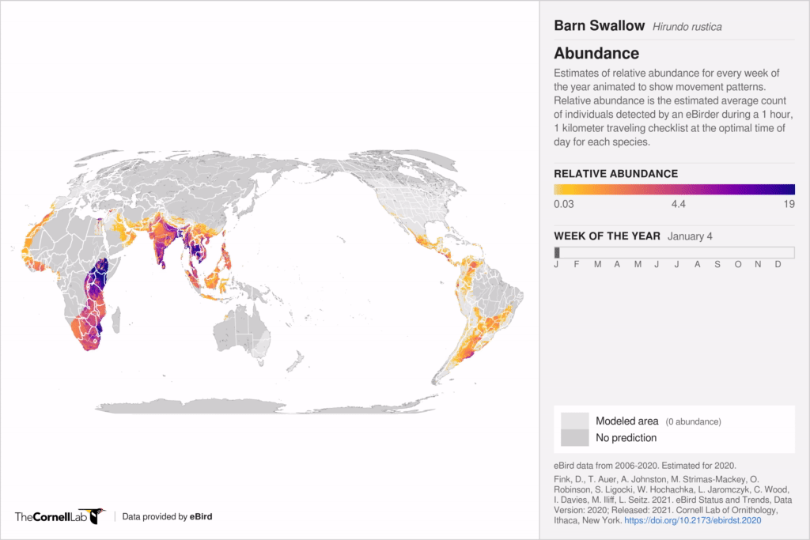
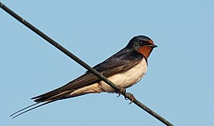
Geographic range in migratory species
Hirundo rustica
Breeding range vs overwintering range.
Source: eBird (https://science.ebird.org/en/status-and-trends/abundance-animations)
Notes:
OK, so here we are moving to the outer space
Spaceborne satellite sensors such as MODIS or Landsat can classify landscape to spectral species, and can measure spectral diversity
Unlike taxonomic data, spectral data suffer no sampling bias and are available over any scale
In WP4 I will seek parallels between dynamics of taxonomic and spectral diversity

Slide 12
You should know
What is species geographic range
What are endemic and pandemic species, plus some examples, ideally different from what I’ve shown
What is native vs invasive, and overwintering vs breeding range (plus some examples)
Notes:
OK, so here we are moving to the outer space
Spaceborne satellite sensors such as MODIS or Landsat can classify landscape to spectral species, and can measure spectral diversity
Unlike taxonomic data, spectral data suffer no sampling bias and are available over any scale
In WP4 I will seek parallels between dynamics of taxonomic and spectral diversity

Slide 13
Range area
And how it’s measured
Notes:
I am qualified to deliver all this

Slide 14
Range area as a fundamental macroecological quantity
Range area correlates with extinction risk and vulnerability to threats.
Range area is a key quantity in invasion biology.
Change in range area (i.e. range contractions and expansions) points to potentially critical processes, both ecological and anthropogenic.
Range area follows macroecological patterns that we will talk about later.
Notes:
In this panel we can probably all agree that biodiversity is one of the most valuable natural resources.
But things like climate change or habitat loss are a threat to biodiversity, to the extent that we hear about biodiversity crisis, or sixth mass extinction
For example, about 1% of vertebrate species have gone extinct because of humans

Slide 15
But how do we get area when species don’t occur everywhere within their range!
Expert-drawn range maps – show where species isn’t, but not where it is
Point occurrences – show where species is, but not where it isn’t.
Notes:
In this panel we can probably all agree that biodiversity is one of the most valuable natural resources.
But things like climate change or habitat loss are a threat to biodiversity, to the extent that we hear about biodiversity crisis, or sixth mass extinction
For example, about 1% of vertebrate species have gone extinct because of humans

Slide 16
Solution 1: Re-label species range to “extent of occurrence”…
… and simply measure the area of the polygon. This works when expert drawn range maps are available.
Notes:
In this panel we can probably all agree that biodiversity is one of the most valuable natural resources.
But things like climate change or habitat loss are a threat to biodiversity, to the extent that we hear about biodiversity crisis, or sixth mass extinction
For example, about 1% of vertebrate species have gone extinct because of humans

Slide 17
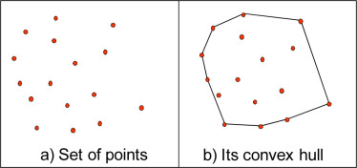
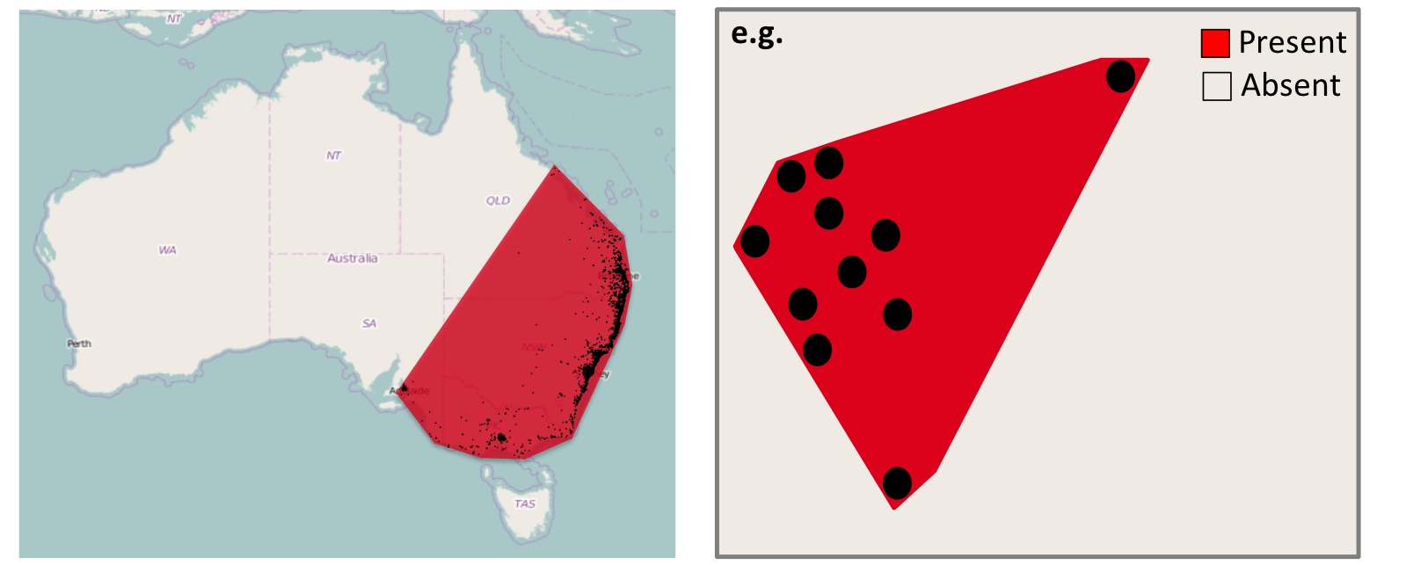
Solution 2: Use point records, make a convex hull, and measure its area
Measures “extent of occurrence” (according to IUCN).
Easy to calculate.
Overestimates presence, similar to expert-drawn range map.
Guidelines for Using the IUCN Red List Categories and Criteria, version 15.1 (2022) IUCN
Notes:
In this panel we can probably all agree that biodiversity is one of the most valuable natural resources.
But things like climate change or habitat loss are a threat to biodiversity, to the extent that we hear about biodiversity crisis, or sixth mass extinction
For example, about 1% of vertebrate species have gone extinct because of humans

Slide 18
Solution 3: Use grids to get Area of Occupancy (AOO)
But how coarse or fine should the grid be?
The coarser the grid, the larger the area!
Guidelines for Using the IUCN Red List Categories and Criteria, version 15.1 (2022) IUCN
Notes:
In this panel we can probably all agree that biodiversity is one of the most valuable natural resources.
But things like climate change or habitat loss are a threat to biodiversity, to the extent that we hear about biodiversity crisis, or sixth mass extinction
For example, about 1% of vertebrate species have gone extinct because of humans

Slide 19
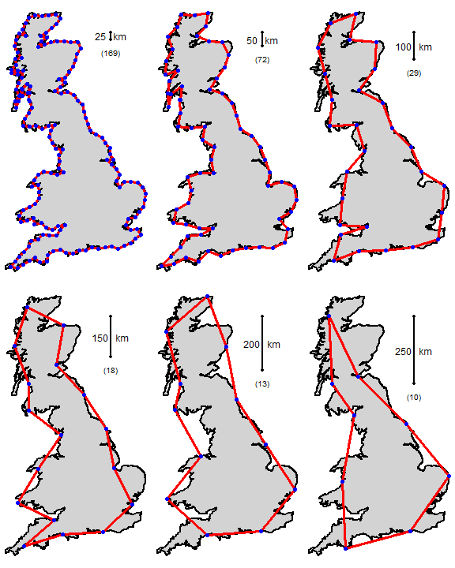
Analogical to the famous problem of scale and the length of the coast of Britain
Maps: Kris Gurung, MSc thesis, 2017
Notes:
In this panel we can probably all agree that biodiversity is one of the most valuable natural resources.
But things like climate change or habitat loss are a threat to biodiversity, to the extent that we hear about biodiversity crisis, or sixth mass extinction
For example, about 1% of vertebrate species have gone extinct because of humans

Slide 20
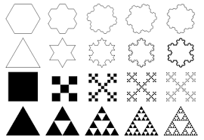

Fractals
Geometric shapes containing detailed structure at arbitrarily small scales, and these structures exhibit self-similarity.
Notes:
In this panel we can probably all agree that biodiversity is one of the most valuable natural resources.
But things like climate change or habitat loss are a threat to biodiversity, to the extent that we hear about biodiversity crisis, or sixth mass extinction
For example, about 1% of vertebrate species have gone extinct because of humans

Slide 21
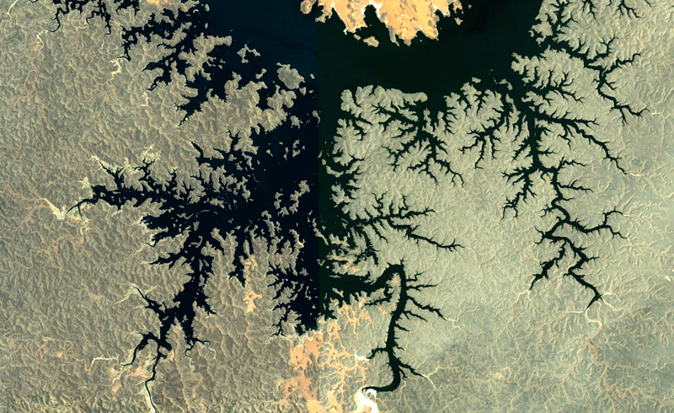
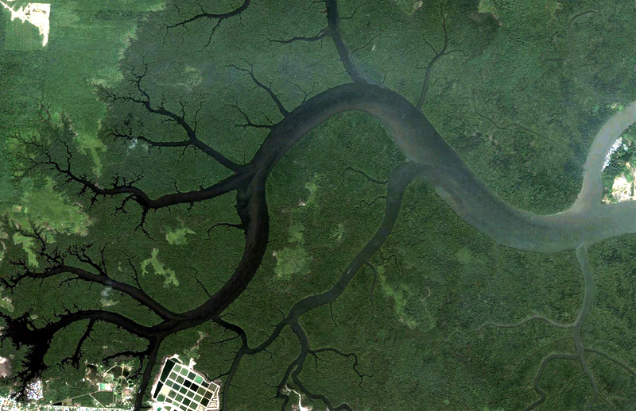
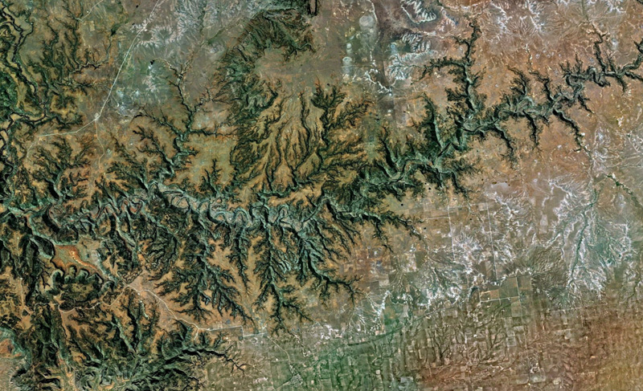
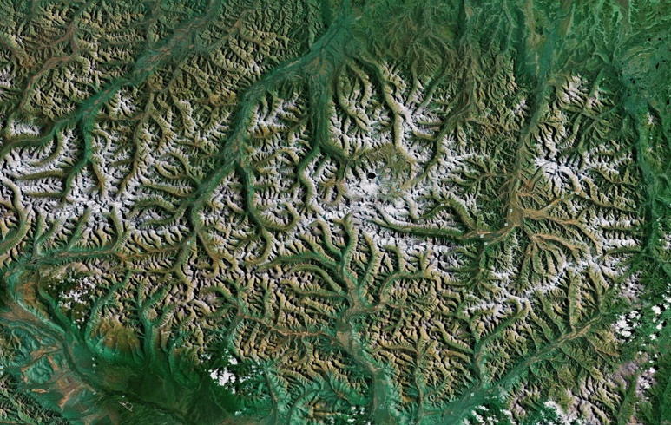
Fractals in geography
Images: Google Earth
Notes:
In this panel we can probably all agree that biodiversity is one of the most valuable natural resources.
But things like climate change or habitat loss are a threat to biodiversity, to the extent that we hear about biodiversity crisis, or sixth mass extinction
For example, about 1% of vertebrate species have gone extinct because of humans

Slide 22
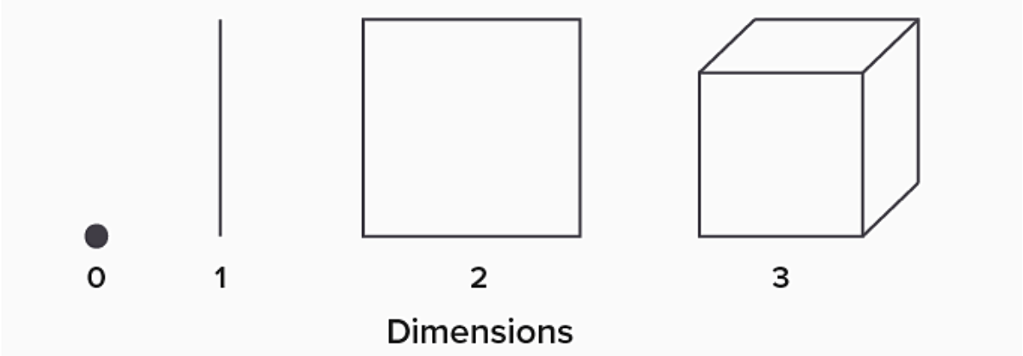
Fractal dimension
Fractal dimension = an index of complexity detail, but also “emptyness”, of a pattern.
It can take values between the integeters, i.e. 1.3, 2.5, etc.
Notes:
In this panel we can probably all agree that biodiversity is one of the most valuable natural resources.
But things like climate change or habitat loss are a threat to biodiversity, to the extent that we hear about biodiversity crisis, or sixth mass extinction
For example, about 1% of vertebrate species have gone extinct because of humans

Slide 23
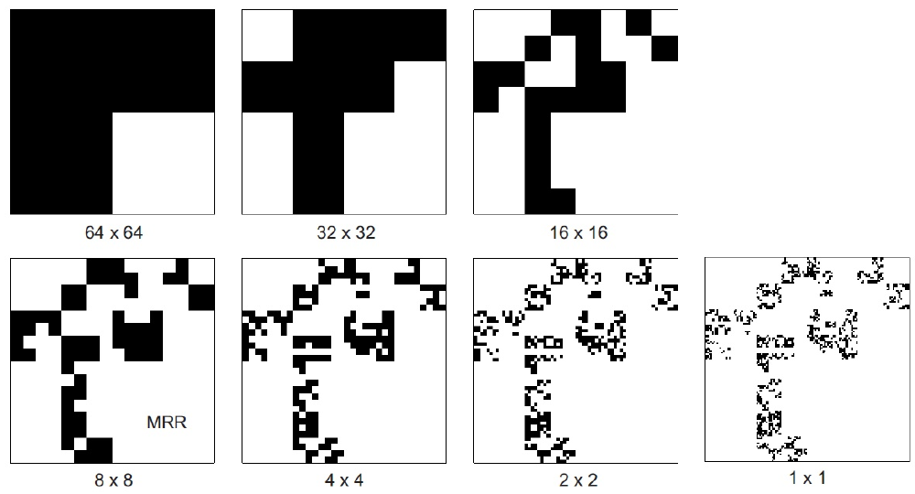
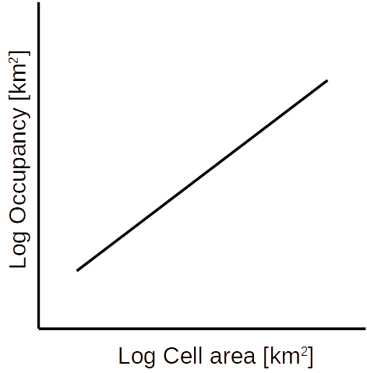
Fractals
The slope of the line is related to fractal dimension, i.e. the “emptynness” or “fill” of the fractal (or species’ range)
Keil et al. (2014) Diversity & Distributions
Notes:
In this panel we can probably all agree that biodiversity is one of the most valuable natural resources.
But things like climate change or habitat loss are a threat to biodiversity, to the extent that we hear about biodiversity crisis, or sixth mass extinction
For example, about 1% of vertebrate species have gone extinct because of humans

Slide 24
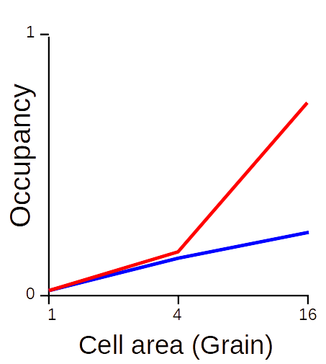
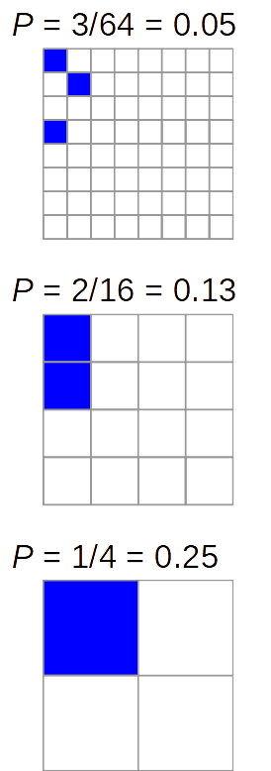
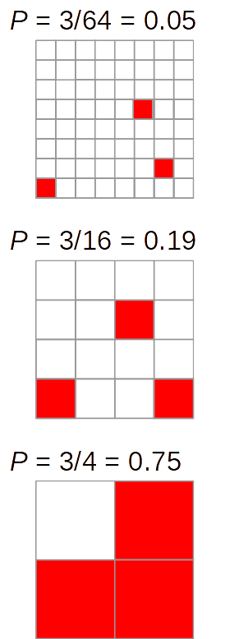
Occupancy-Area Relationship and species aggregation
Steeper slope = more dispersed
Shallow slope = aggregated
Also known as:
Occupancy-area relationship (He & Condit 2007)
Scale-area relationship (Kunin 1998)
Range-area relationship (Harte et al. 2005)
Scaling pattern of occupancy (Hui et al. 2009)
Notes:
In this panel we can probably all agree that biodiversity is one of the most valuable natural resources.
But things like climate change or habitat loss are a threat to biodiversity, to the extent that we hear about biodiversity crisis, or sixth mass extinction
For example, about 1% of vertebrate species have gone extinct because of humans

Slide 25
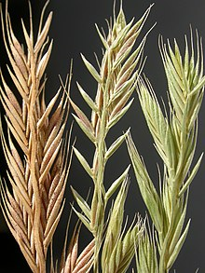
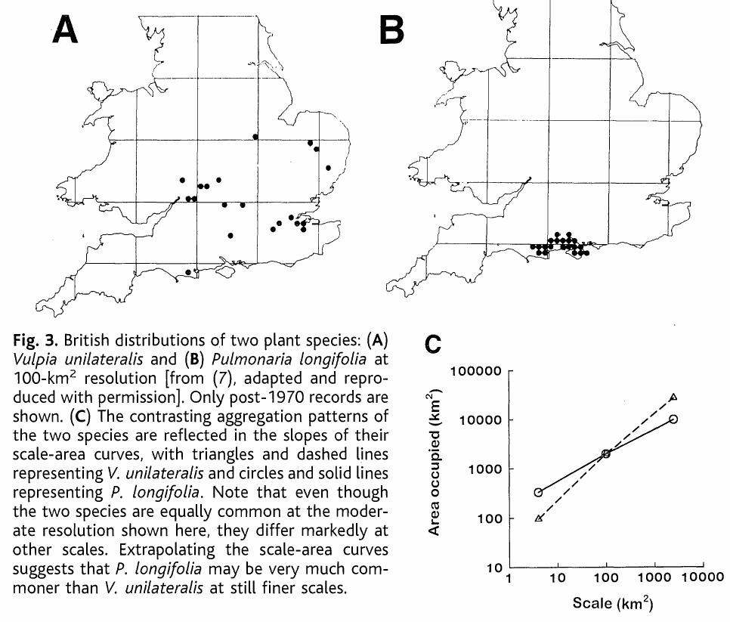
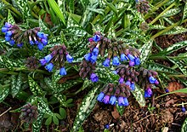
Occupancy-Area Relationship and species aggregation
Note the low (left) and high (right) fractal dimension.
Kunin (1998) Science
Notes:
In this panel we can probably all agree that biodiversity is one of the most valuable natural resources.
But things like climate change or habitat loss are a threat to biodiversity, to the extent that we hear about biodiversity crisis, or sixth mass extinction
For example, about 1% of vertebrate species have gone extinct because of humans

Slide 26
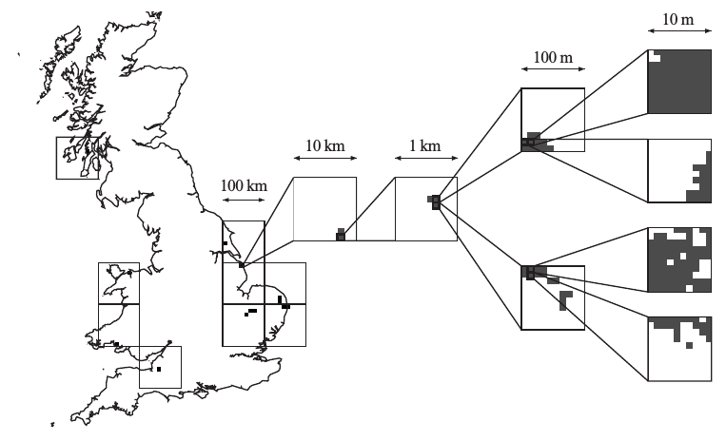
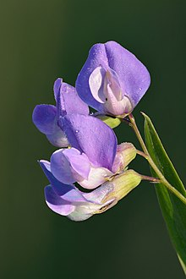
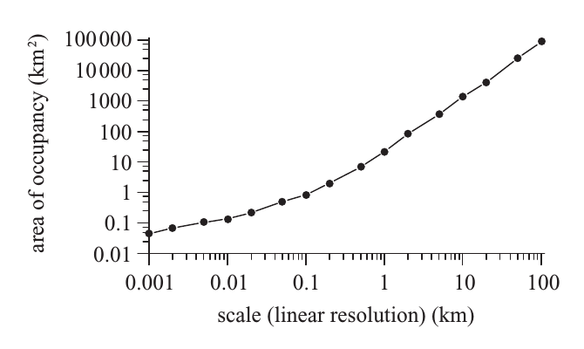
Empirical occupancy-area relationships
Lathyrus palustris
Hartley (2004) Proc. R. Soc. B
Notes:
In this panel we can probably all agree that biodiversity is one of the most valuable natural resources.
But things like climate change or habitat loss are a threat to biodiversity, to the extent that we hear about biodiversity crisis, or sixth mass extinction
For example, about 1% of vertebrate species have gone extinct because of humans

Slide 27
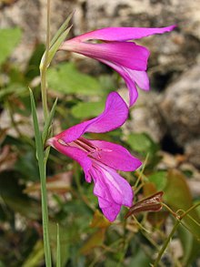
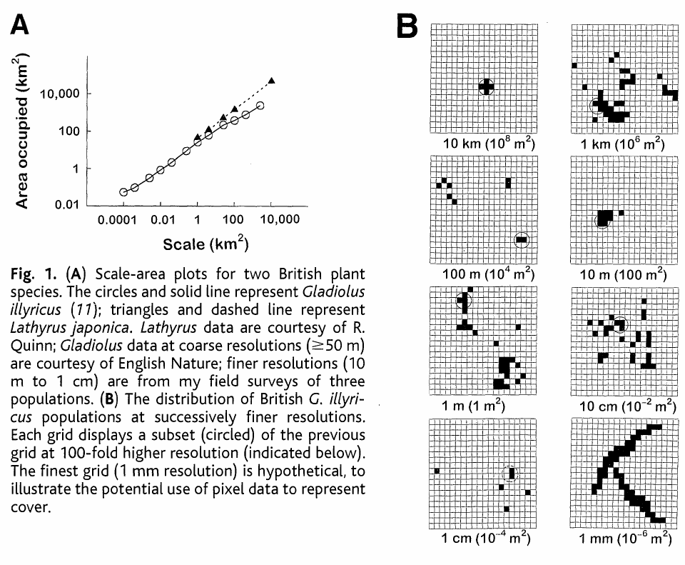
Empirical scaling of occupancy
Gladiolus illyricus
(mečík illirský)
Kunin (1998) Science
Notes:
In this panel we can probably all agree that biodiversity is one of the most valuable natural resources.
But things like climate change or habitat loss are a threat to biodiversity, to the extent that we hear about biodiversity crisis, or sixth mass extinction
For example, about 1% of vertebrate species have gone extinct because of humans

Slide 28
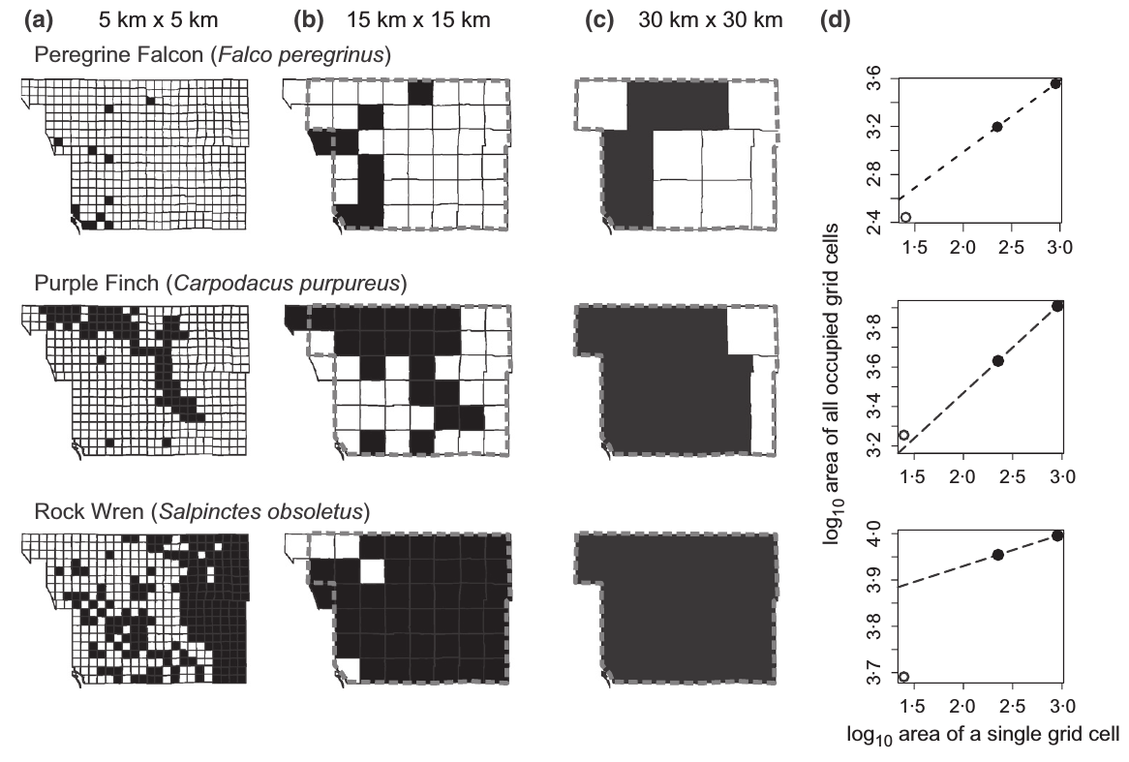
We can use the relationship to downscale species occupancy …
In other words, we can estimate local abundance from coarse-scale gridded atlas data.
Keil et al. (2013) Methods in Ecology and Evolution
Notes:
In this panel we can probably all agree that biodiversity is one of the most valuable natural resources.
But things like climate change or habitat loss are a threat to biodiversity, to the extent that we hear about biodiversity crisis, or sixth mass extinction
For example, about 1% of vertebrate species have gone extinct because of humans

Slide 29
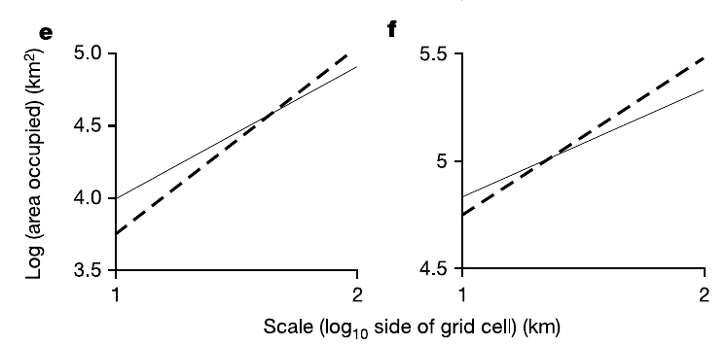
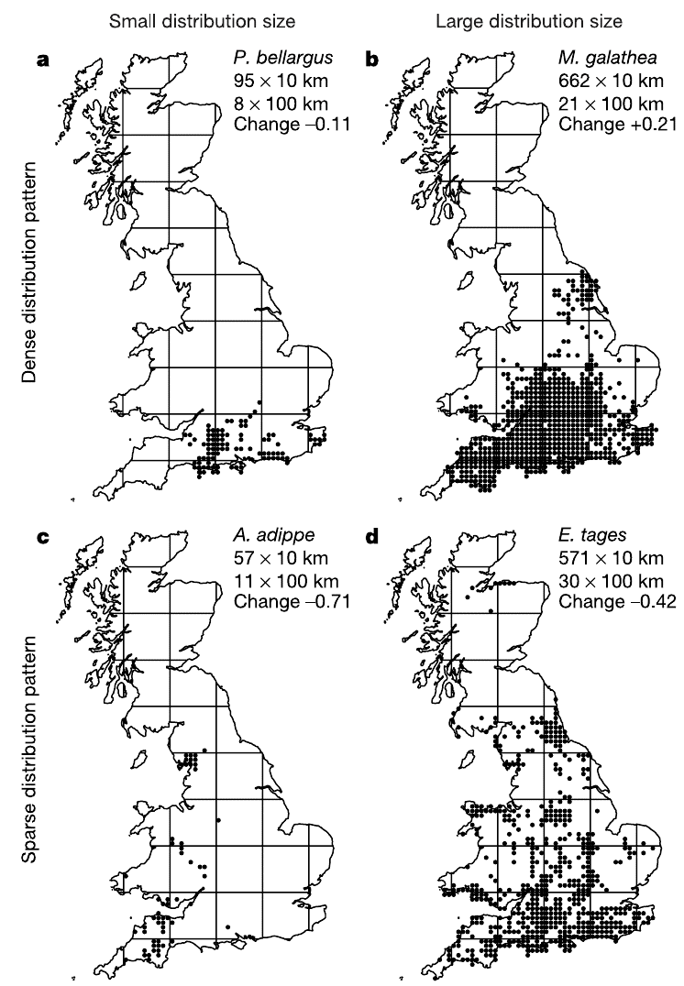
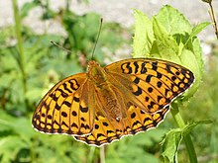
… or maybe we can estimate biodiversity change from static scaling
M. galathea
Modrásek
jetelový
Okac bojinkovy
P. bellargus
A. adippe
E. tages
Expanding ranges have different occupancy-area relationship than contracting ranges.
Perleťovec
prostřední
Soumračník
máčkový
Wilson et al. (2004) Nature
Notes:
In this panel we can probably all agree that biodiversity is one of the most valuable natural resources.
But things like climate change or habitat loss are a threat to biodiversity, to the extent that we hear about biodiversity crisis, or sixth mass extinction
For example, about 1% of vertebrate species have gone extinct because of humans

Slide 30
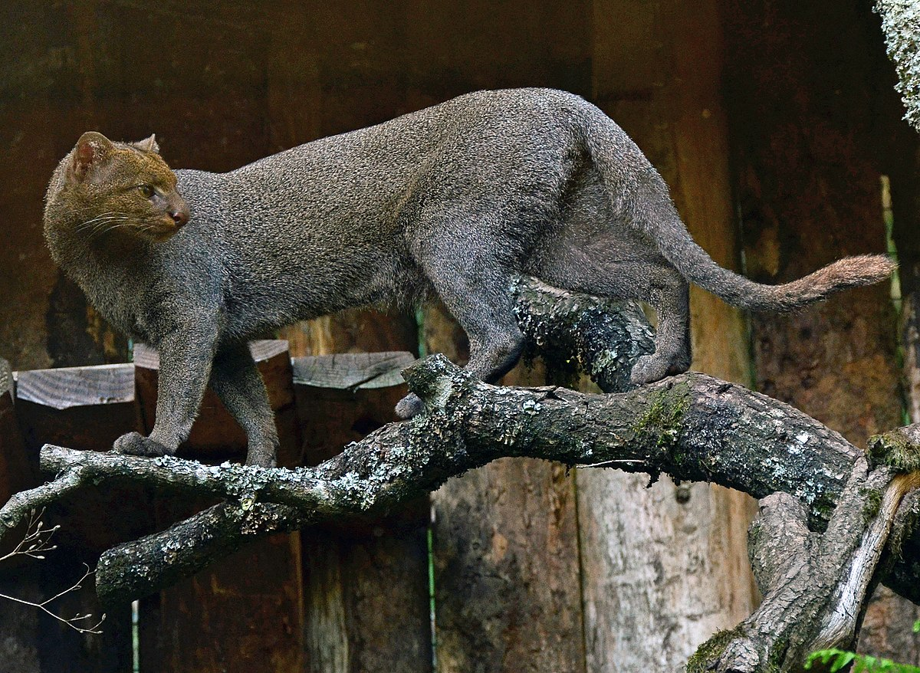
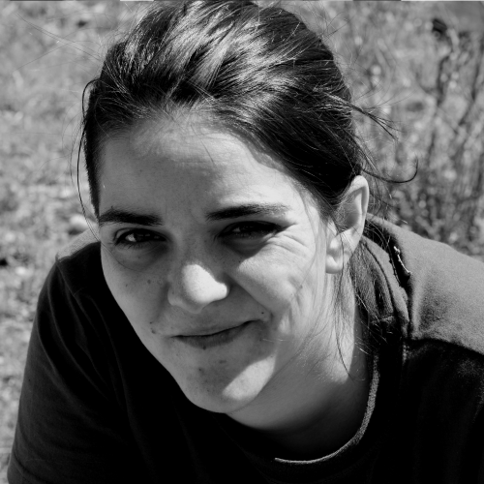
Geographic range as a probability surface
Herpailurus yagouaroundi
When distribution of a species is described by probability of presence, then range area (the number of occupied grid cells) is just the sum of probabilities across all grid cells.
Grattarola, Bowler & Keil (2022) EcoEvoRxiv
Notes:
In this panel we can probably all agree that biodiversity is one of the most valuable natural resources.
But things like climate change or habitat loss are a threat to biodiversity, to the extent that we hear about biodiversity crisis, or sixth mass extinction
For example, about 1% of vertebrate species have gone extinct because of humans

Slide 31
Geographic range as a probability surface
Herpailurus yagouaroundi
When distribution of a species is described by probability of presence, then range area (the number of occupied grid cells) is just the sum of probabilities across all grid cells.
Grattarola, Bowler & Keil (2022) EcoEvoRxiv
Notes:
In this panel we can probably all agree that biodiversity is one of the most valuable natural resources.
But things like climate change or habitat loss are a threat to biodiversity, to the extent that we hear about biodiversity crisis, or sixth mass extinction
For example, about 1% of vertebrate species have gone extinct because of humans

Slide 32
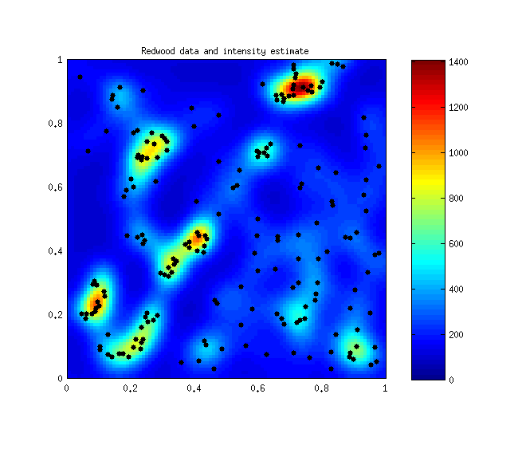
Geographic range as a point process intensity
This is where the cutting edge is, still not widely used.
Grattarola, Bowler & Keil (2022) EcoEvoRxiv
Isaac, Jarzyna, Keil et al. (2019) Trends in Ecology and Evolution
Notes:
In this panel we can probably all agree that biodiversity is one of the most valuable natural resources.
But things like climate change or habitat loss are a threat to biodiversity, to the extent that we hear about biodiversity crisis, or sixth mass extinction
For example, about 1% of vertebrate species have gone extinct because of humans

Slide 33
You should know
Why is area of geographic range important
What are problems with measuring range area for point records and expert-drawn range maps, and what is the fundamental difference between them
Roughly, how is range geometry related to fractals
What is occupancy-area relationship, and how is related to spatial aggregation
Which other phenomena outside of ecology behave similarly to ranges?
- Disease incidence
- Geographic distributions of natural resources
- Fire incidence, accident incidence, incidence of insurance events, earhquakes
Notes:
OK, so here we are moving to the outer space
Spaceborne satellite sensors such as MODIS or Landsat can classify landscape to spectral species, and can measure spectral diversity
Unlike taxonomic data, spectral data suffer no sampling bias and are available over any scale
In WP4 I will seek parallels between dynamics of taxonomic and spectral diversity

Slide 34
What drives range size?
Physiology, evolution, barriers
Notes:
I am qualified to deliver all this

Slide 35

Barriers
The world is full of barriers …
Notes:
And this is what I will address
The grand objective is to figure out…
Specifically, BEAST will ………………………
I will do this in 5 work packages.

Slide 36

Barriers
.. and they move around.
Notes:
And this is what I will address
The grand objective is to figure out…
Specifically, BEAST will ………………………
I will do this in 5 work packages.

Slide 37

Barriers
.. and they move around.
Last glaciation in Europe 70,000-20,000 BP
Map: Wikimedia Commons user Ulamm
Notes:
And this is what I will address
The grand objective is to figure out…
Specifically, BEAST will ………………………
I will do this in 5 work packages.

Slide 38

Geographic ranges as an outcome of evolution and speciation
Notes:
And this is what I will address
The grand objective is to figure out…
Specifically, BEAST will ………………………
I will do this in 5 work packages.

Slide 39

Geographic ranges as an outcome of evolution and speciation
Notes:
And this is what I will address
The grand objective is to figure out…
Specifically, BEAST will ………………………
I will do this in 5 work packages.

Slide 40

Geographic ranges as an outcome of evolution and speciation
Notes:
And this is what I will address
The grand objective is to figure out…
Specifically, BEAST will ………………………
I will do this in 5 work packages.

Slide 41

Geographic ranges as an outcome of evolution and speciation
Notes:
And this is what I will address
The grand objective is to figure out…
Specifically, BEAST will ………………………
I will do this in 5 work packages.

Slide 42

Global patterns of range size
Empirical study: geographic constraints and environment are the main drivers of range size evolution of range size in carnivorans:
Machac et al. (2011) American Naturalist
Phylogeny image: Wikimedia commons
Notes:
And this is what I will address
The grand objective is to figure out…
Specifically, BEAST will ………………………
I will do this in 5 work packages.

Slide 43
You should know
That geographic range, and its size, is a result of an interplay between barriers, niches, and macroevolutionary processes
You should know at least two modes of speciation (e.g. allopatric vs sympatric)
Notes:
OK, so here we are moving to the outer space
Spaceborne satellite sensors such as MODIS or Landsat can classify landscape to spectral species, and can measure spectral diversity
Unlike taxonomic data, spectral data suffer no sampling bias and are available over any scale
In WP4 I will seek parallels between dynamics of taxonomic and spectral diversity

Slide 44
Patterns of range size and geometry
Where are the largest ranges? Where are the endemic species?
Notes:
I am qualified to deliver all this

Slide 45
What if we put together all the known species of birds and map their ranges?
Total number of species in 100 x 100 km grid cells
(there is > 11,000 known bird species today)
Orme et al. (2006) PLoS Biology
Notes:
And this is what I will address
The grand objective is to figure out…
Specifically, BEAST will ………………………
I will do this in 5 work packages.

Slide 46
Range size distributions
Histograms show frequency distribution of bird range sizes globally.
Most species have small ranges, only a few species are cosmopolitan.
Note the logarithmic scale!
Orme et al. (2006) PLoS Biology
Notes:
And this is what I will address
The grand objective is to figure out…
Specifically, BEAST will ………………………
I will do this in 5 work packages.

Slide 47

Large-scale range size distributions vs local abundance distributions
Most species are also locally rare, i.e. they have low abundances. There are not that many species that are locally abundant.
Note the logarithmic scale!
Log2 of abundance
Matthews & Whittaker (2014) J. Appl. Ecol.
Notes:
And this is what I will address
The grand objective is to figure out…
Specifically, BEAST will ………………………
I will do this in 5 work packages.

Slide 48
At smaller extents, occupancy distributions can be bimodal
This is consistent with Hanski’s core-satellite hypothesis, more on that next week.
Storch & Sizling (2002) Ecography
Hanski (1982) Oikos
Notes:
And this is what I will address
The grand objective is to figure out…
Specifically, BEAST will ………………………
I will do this in 5 work packages.

Slide 49
So are species with large ranges also locally abundant?
!
Species with large ranges should have larger local abundances.
Mostly holds, with some exceptions and a lot of variation around the relationship.
Gaston, Balckburn & Lawton (1997) J. Anim. Ecol.
Brown (1995) Macroecology
Notes:
And this is what I will address
The grand objective is to figure out…
Specifically, BEAST will ………………………
I will do this in 5 work packages.

Slide 50
Abundance-range size relationship is sometimes completely absent
Sporbert, Keil et al. (2019) Journal of Biogeography
Reif et al. (2006) J. Biogeogr
Notes:
And this is what I will address
The grand objective is to figure out…
Specifically, BEAST will ………………………
I will do this in 5 work packages.

Slide 51
Rapoport’s rule
Latitudinal ranges of plants and animals should be smaller around the tropics, and increase towards the poles.
Controversial, mixed support
Median geographic range size in birds
Median latitudinal extent in birds
Stevens (1989) American Naturalist
Orme et al. (2006) PLoS Biology
Notes:
And this is what I will address
The grand objective is to figure out…
Specifically, BEAST will ………………………
I will do this in 5 work packages.

Slide 52
Empirical example of (the lack of) Rapoport’s rule in global birds
Orme et al. (2006) PLoS Biology
Notes:
And this is what I will address
The grand objective is to figure out…
Specifically, BEAST will ………………………
I will do this in 5 work packages.

Slide 53
Empirical example of (the lack of) Rapoport’s rule in global birds
But if species have larger climatic tolerances towards the poles, why don’t they also have larger ranges?
Notes:
And this is what I will address
The grand objective is to figure out…
Specifically, BEAST will ………………………
I will do this in 5 work packages.

Slide 54

The barriers, again …
Sizling, Storch & Keil (2009) Ecology
Notes:
And this is what I will address
The grand objective is to figure out…
Specifically, BEAST will ………………………
I will do this in 5 work packages.

Slide 55

Abundance-centrality hypothesis
Inula conyzae
Local populations should be larger close to the center of geographic ranges
Does not work, barriers and topography are to blame!
Sporbert, Keil et al. (2019) Journal of Biogeography
Notes:
And this is what I will address
The grand objective is to figure out…
Specifically, BEAST will ………………………
I will do this in 5 work packages.

Slide 56
You should know
At least two macroecological patterns of geographic range, and/or their size
Notes:
OK, so here we are moving to the outer space
Spaceborne satellite sensors such as MODIS or Landsat can classify landscape to spectral species, and can measure spectral diversity
Unlike taxonomic data, spectral data suffer no sampling bias and are available over any scale
In WP4 I will seek parallels between dynamics of taxonomic and spectral diversity

Slide 57
Thank you. Questions?

